Slide 1

CS47: Cross-Platform Mobile Development
Lecture 4B: Component Lifecycle + Debugging
James Landay
Abdallah AbuHashem
Tiffany Manuel
Cisco Vlahakis
Vy Mai
Fall 2019
https://cs47.stanford.edu
cs47-fall19.slack.com

Slide 2

Live Exercise
To-Do List
Run npm install
Open with Expo

Slide 3
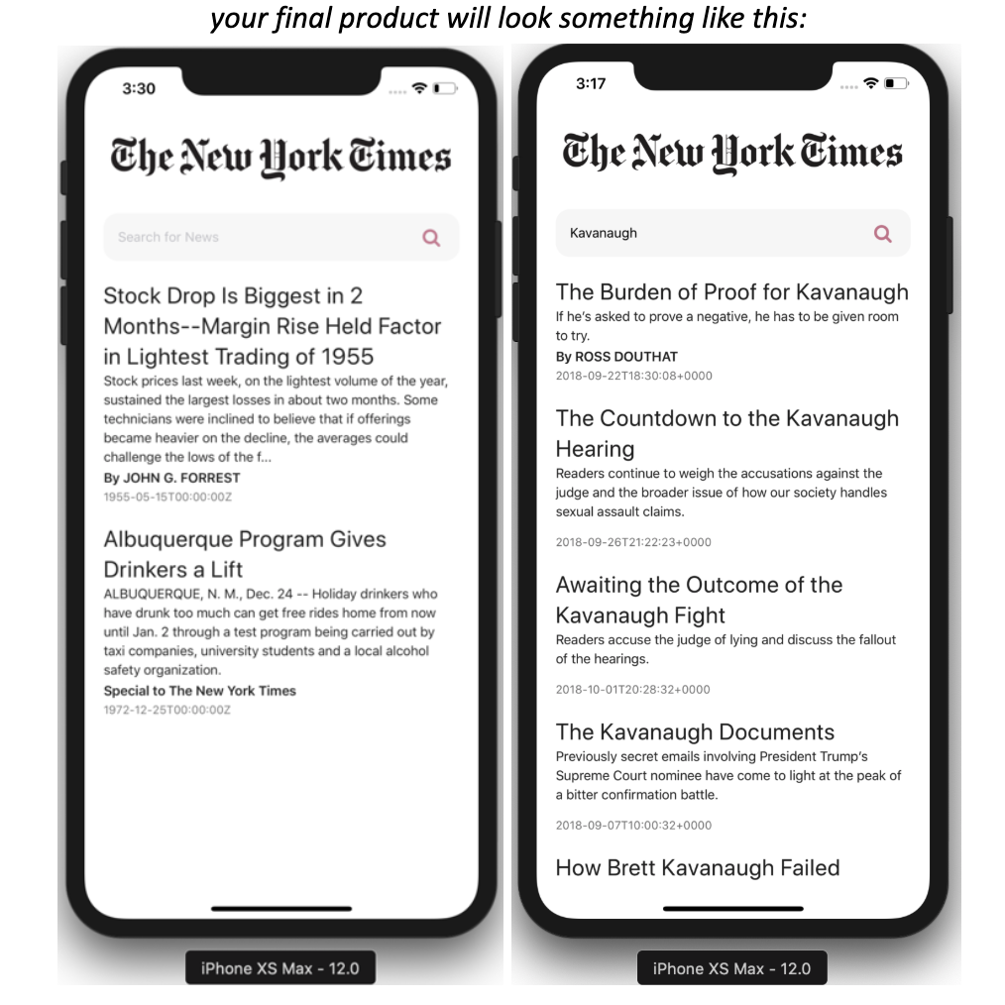
Assignment 3 is due at midnight
Notes:
Other announcements:
“Mini Assignment” = Final project write up (released today)
(Last assignment) Assignment 4 will be released on Tuesday

Slide 4

Overview for today
Component Life Cycle
useEffect Hook
Debugging

Slide 5
Overview for today
Component Life Cycle
useEffect Hook
Debugging

Slide 6
Hooks
Functions that allow you to “hook into” React state and life cycle features from function components.
Two Rules of Hooks
1) Only call Hooks at the top level
2) Only call Hooks from React
functional components
Notes:
When we defined Hooks, we briefly mentioned React life cycle features. Today, we will be explaining what we mean by this.

Slide 7
constructor
constructor(props) {
super(props); // Allows you to use “this”
// Initialize state
this.state = {
headline: 'Welcome to my app!'
}
}
Notes:
Consider this to be like componentWillMount (which is deprecated)

Slide 8
componentDidMount
componentDidMount() {
// Fetching data from API
// Changing the DOM
});
Notes:
Occurs after component successfully renders for the first time
Notice that it’s not a fat arrow function because in this case it is unnecessary and would actually hurt our performance

Slide 9
componentDidUpdate
componentDidUpdate(prevProps, prevState) {
// Updating third party UI elements
});
Notes:
Gets called if component’s props or state change
Two parameters (prevProps and prevState)

Slide 10
componentWillUnmount
componentWillUnmount() {
// Performing cleanups
// Ex: cancelling network requests
});

Slide 11
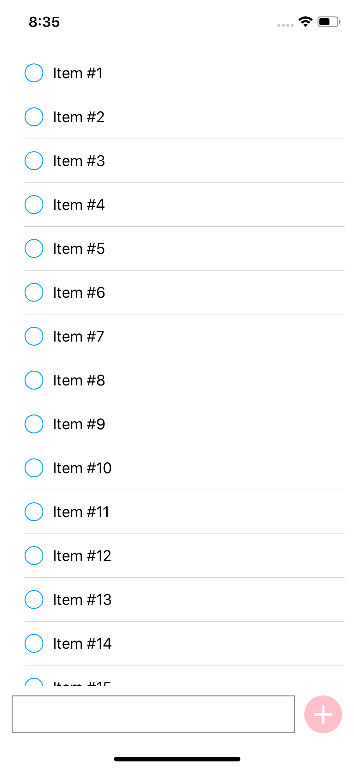

Follow along code
https://reflect.sh/vagabond-hair
Helpful links
setInterval
Live Exercise
To-Do List
Complete componentDidMount and componentWillUnmount

Slide 12
RN App Life-cycle
http://projects.wojtekmaj.pl/react-lifecycle-methods-diagram/
USEFUL RESOURCES / React Lifecycle
Notes:
Side effects: anything that affects something outside the scope of the function being executed (ex: making a network request, changing the DOM)
Just like state, these life cycle functions are only available for class components. However...

Slide 13
state object
(Class Components)
useState Hook
(Functional Components)
const [x, setX] = useState(z)
setX(y)
import { useState } from 'react';
state = { x: z }
this.setState({ x: y })
Notes:
Recall how the useState Hook allowed us to access the state feature in functional components. There is also a Hook that allows us to use life cycle features in functional components.

Slide 14
Overview for today
Component Life Cycle
useEffect Hook
Debugging

Slide 15
Overview for today
Component Life Cycle
useEffect Hook
Debugging

Slide 16
Live Exercise
To-Do List
Run npm install
Open with Expo

Slide 17
Life cycle functions
(Class Components)
useEffect Hook
(Functional Components)
import { useEffect } from 'react';
componentDidMount
componentDidUpdate
componentWillUnmount
useEffect(
() => {
// Fetch data from API
// Perform cleanup
// etc.
},
// Array of dependencies
// Used for optimization
// Optional
[]
);
USEFUL RESOURCES / React Docs
Notes:
Where you would use the life cycle functions in class components, you would use the useEffect Hook in functional components.
Pros to using useEffect over life cycle components: common to have to repeated code in two life cycle functions. Ex: you’re using the state to manipulate something in the DOM, so you would do this in componentDidMount and componentDidUpdate.

Slide 18
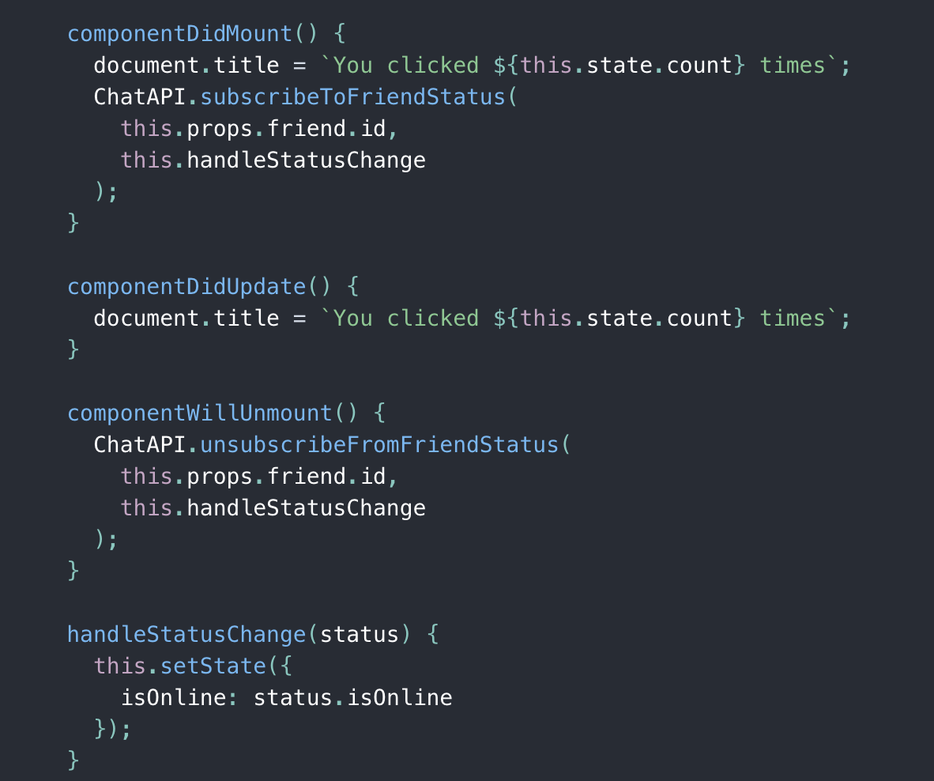
Example of useEffect Hook
SOURCE / React Docs

Slide 19
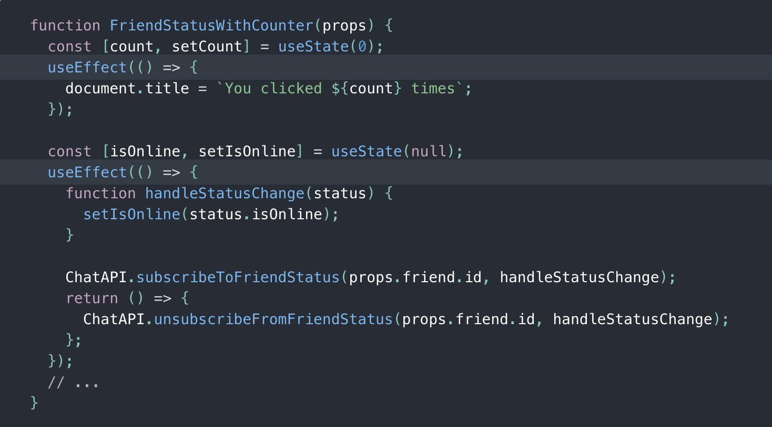
Example of useEffect Hook
SOURCE / React Docs
Notes:
Notice that you can use “useEffect” multiple times to help separate logic.
In the second “useEffect,” we return a function, which us the optional cleanup mechanism for the “useEffect” hook. Basically, any cleanup that you would do in “componentWillUnmount” should be done within this cleanup function.

Slide 20
Follow along code
https://reflect.sh/liked-achiever
Helpful links
setInterval
Live Exercise
To-Do List
Complete useEffect
Notes:
Use “useEffect” to simulate what we did with componentDidMount and componentWillUnmount

Slide 21
Overview for today
Component Life Cycle
useEffect Hook
Debugging

Slide 22

5 Minute Break

Slide 23
Overview for today
Component Life Cycle
useEffect Hook
Debugging

Slide 24
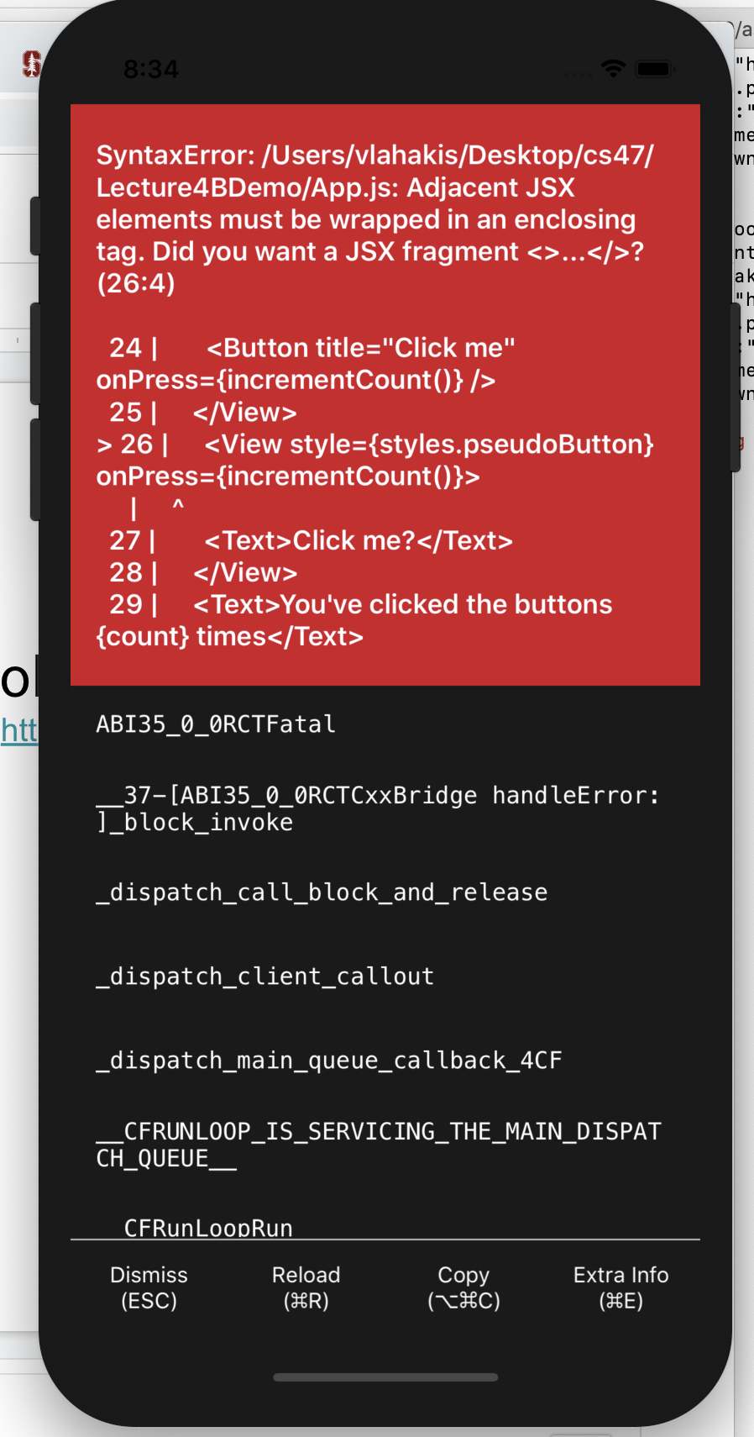
Follow along code
https://reflect.sh/sole-sister
GitHub
Live Exercise
Debugging Egg-Hunt
Can you spot (and fix!) all 8 errors?
Notes:
Bugs:
// Require an image not there
// Put a comment in code
// Calling a function immediately instead of thru callback
// Rendering two siblings without a parent
// Put functional component code in class code
// Misspelling the style params
// putting onpress on view instead of touchableopacity
// Not exporting the component

Slide 25
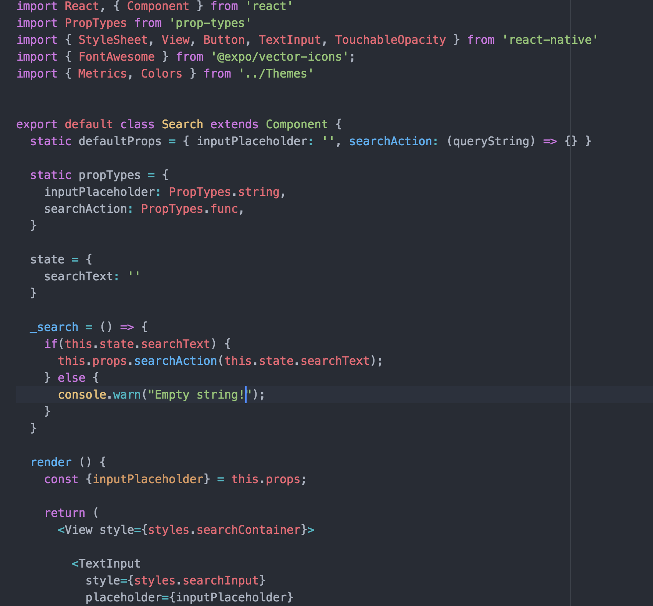


Slide 26
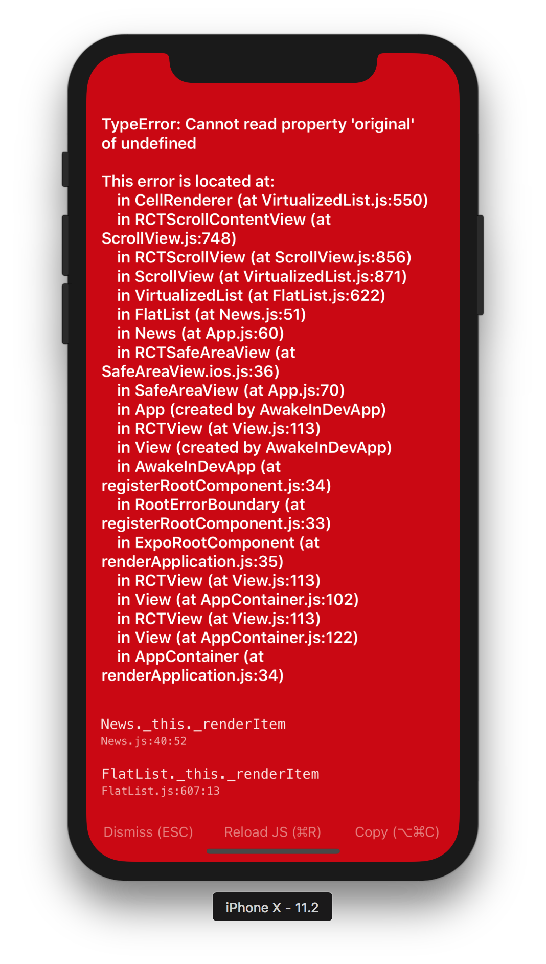

Slide 27
How might I get started on debugging my code?

Slide 28


Slide 29

Notes:
Use DevTools!
console.log()
Helps with printing out objects (collapse)
All fetch calls (successful, error messages, url that was used, headers, response)

Slide 30
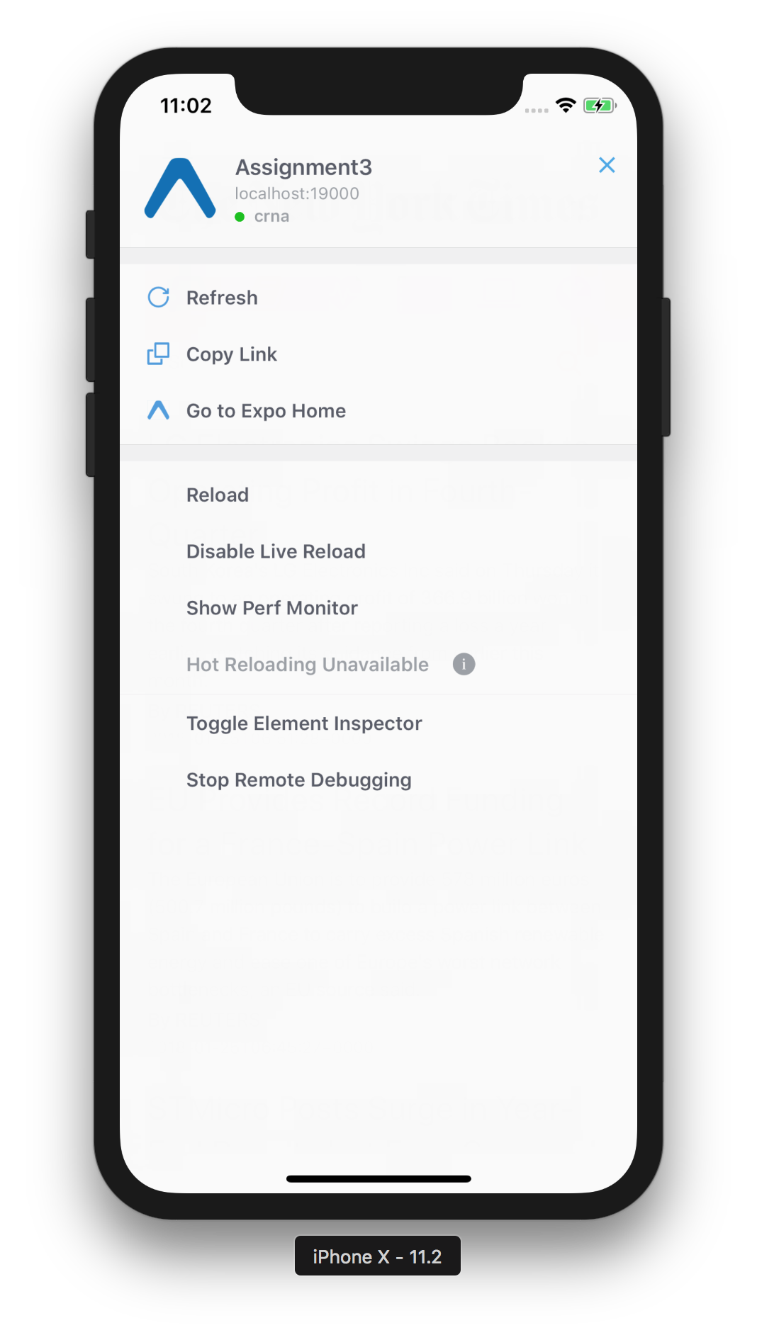
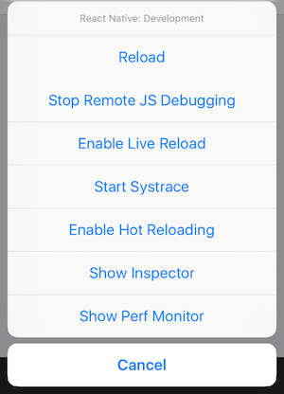
{
⌘D (iOS)
⌘M (Android)
or shake your device!

Slide 31
Reloads your entire app, from scratch.

Slide 32
Reloads your entire app, from scratch.
Reload entire app when you make a change.
(you’ll lose your state with both of these)

Slide 33
Reloads your entire app, from scratch.
Reload entire app when you make a change.
(literally) show’s a performance monitor

Slide 34
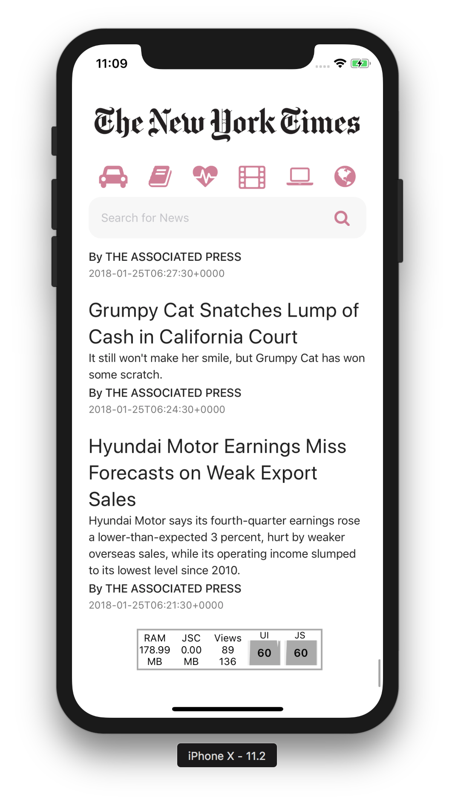
Reloads your entire app, from scratch.
Reload entire app when you make a change.
(literally) show’s a performance monitor

Slide 35
Notes:
RAM usage. JSC JS thread? Views? UI and JS are frames/s (should expect to go down when doing animations)

Slide 36
iOS devices display 60 frames per second
(this gives the UI system about 16.67ms to generate a frame)

Slide 37
iOS devices display 60 frames per second
(this gives the UI system about 16.67ms to generate a frame)
JS frame rate | UI frame rate
This is where your app lives. All events are processed here (touch, networking, etc). If anything takes longer than 100ms, user will notice. | The “main” thread. This is calculated at the native level. Some components, like the ScrollView, live on the main thread.
Notes:
A component in the main thread = faster! They are not interrupted by frame drops on the JavaScript thread.

Slide 38
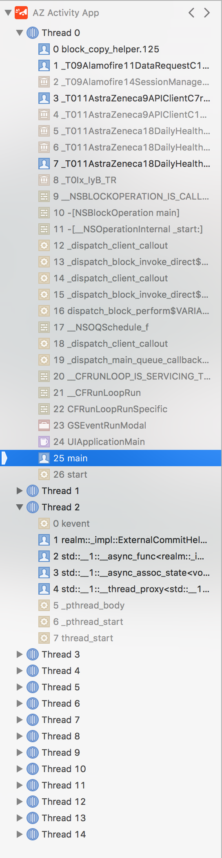
What are threads, anyways?
And why are they relevant?
Notes:
iOS app pictured. See main thread. Background thread should be used for intensive tasks, so you don’t block the main thread.

Slide 39
Some things to keep in mind...
Performance is actually faster when you release/publish the application. This is because developer tools use up a lot of resources.
JS FPS plunges when re-rendering a view that hardly changes
Implement shouldComponentUpdate(nextProps, nextState) when needed.
Moving a view on the screen (scrolling, translating, rotating) drops UI thread FPS.
Animating the size of an image drops UI thread FPS, unless you use the transform: [{scale}] style property (i.e. when you “tap to zoom”).
Notes:
We’ll be sharing more tips and tricks with you as we build new, better, apps.

Slide 40
Reloads your entire app, from scratch.
Reload entire app when you make a change.
(literally) show’s a performance monitor

Slide 41
Reloads your entire app, from scratch.
Reload entire app when you make a change.
(literally) show’s a performance monitor
Reload parts of app (keeps state!)
Notes:
It’s unavailable because live reloading is enabled. We either use one, or the other. Useful for UI-only changes.

Slide 42
Reloads your entire app, from scratch.
Reload entire app when you make a change.
(literally) show’s a performance monitor
Reload parts of app (keeps state!)
See styles of every component

Slide 43
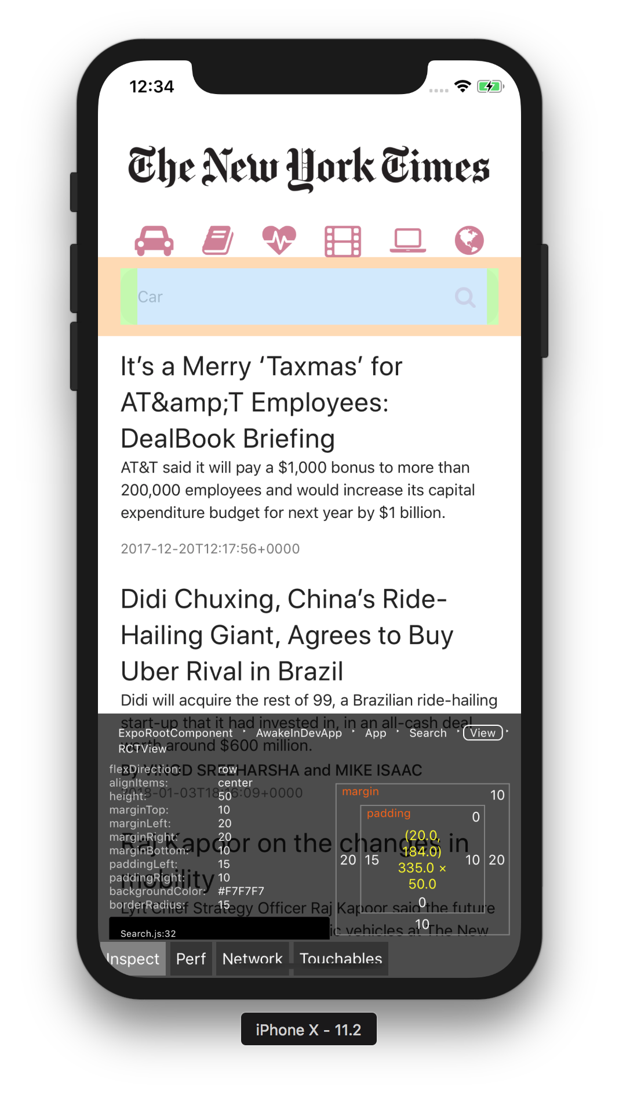
Reloads your entire app, from scratch.
Reload entire app when you make a change.
(literally) show’s a performance monitor
Reload parts of app (keeps state!)
See styles of every component

Slide 44
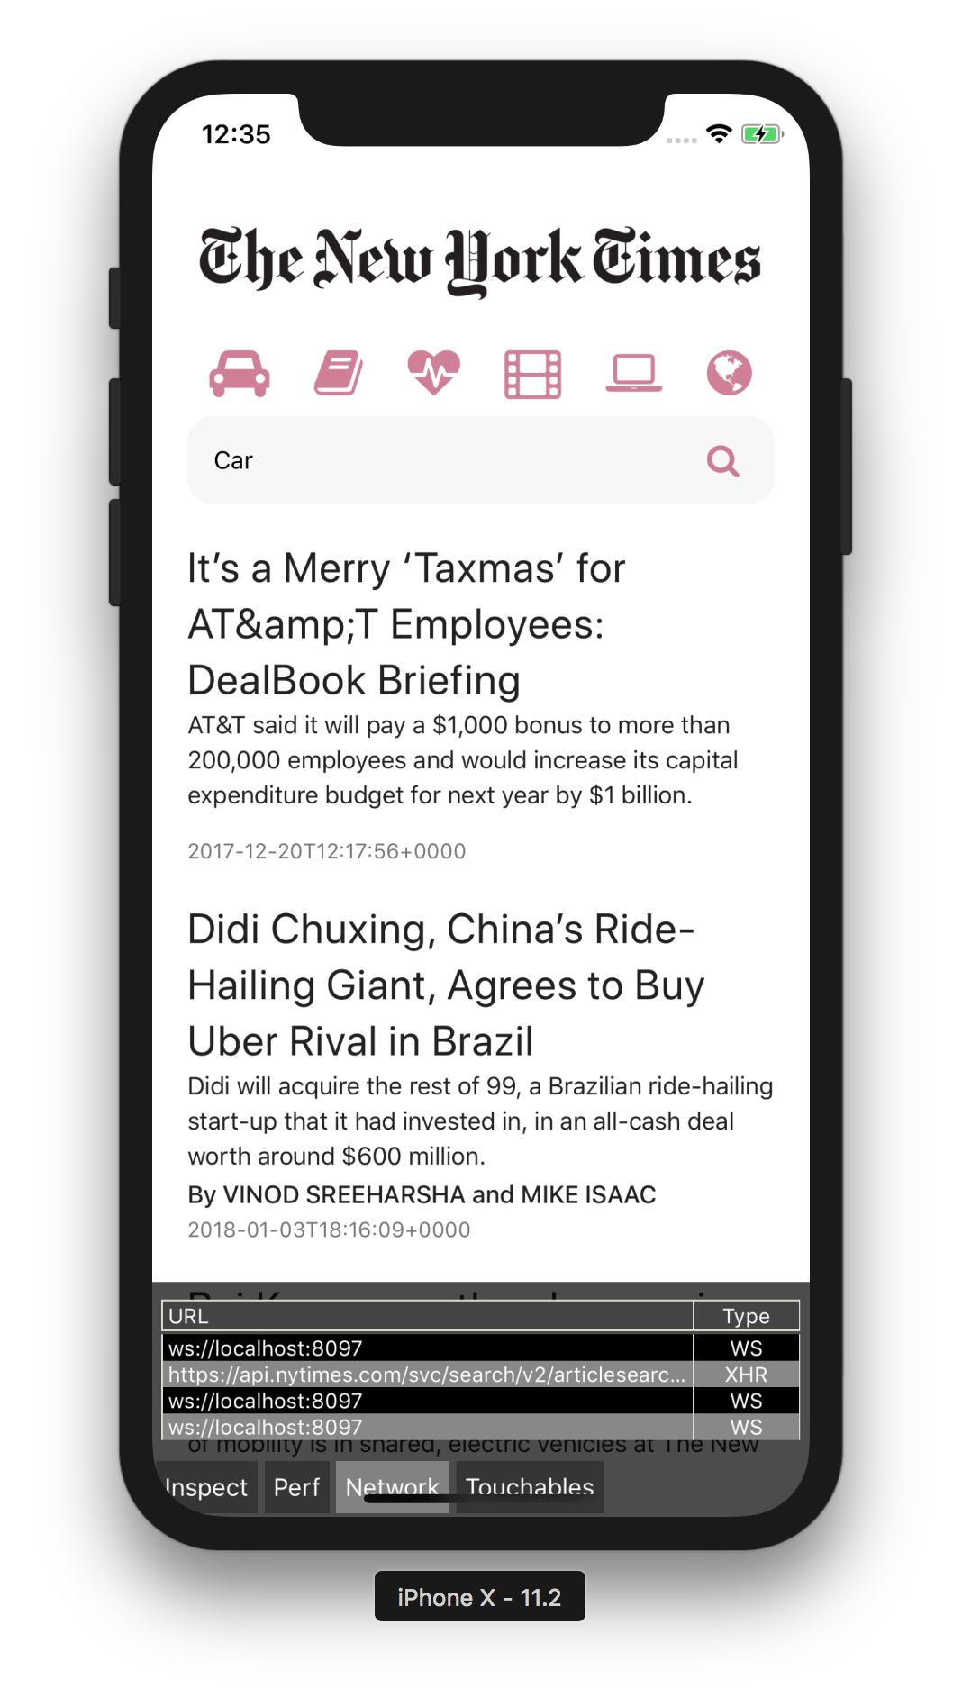
Reloads your entire app, from scratch.
Reload entire app when you make a change.
(literally) show’s a performance monitor
Reload parts of app (keeps state!)
See styles of every component
(and some extra stuff)

Slide 45

Reloads your entire app, from scratch.
Reload entire app when you make a change.
(literally) show’s a performance monitor
Reload parts of app (keeps state!)
See styles of every component
(and some extra stuff)

Slide 46
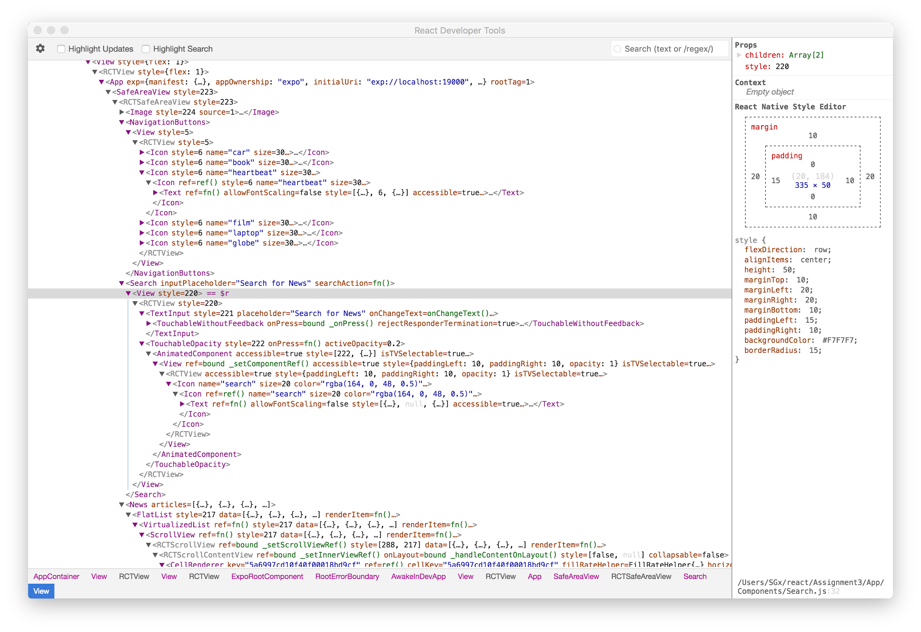
https://www.npmjs.com/package/react-devtools

Slide 47
Reloads your entire app, from scratch.
Reload entire app when you make a change.
(literally) show’s a performance monitor
Reload parts of app (keeps state!)
See styles of every component
Chrome, Breakpoints, Console, + more!

Slide 48
Follow along code
https://reflect.sh/sole-sister
GitHub
Live Exercise
Debugging Egg-Hunt
Can you spot (and fix!) all 8 errors?
Notes:
Bugs:
// Require an image not there
// Put a comment in code
// Calling a function immediately instead of thru callback
// Rendering two siblings without a parent
// Put functional component code in class code
// Misspelling the style params
// putting onpress on view instead of touchableopacity
// Not exporting the component

Slide 49
CS47: Cross-Platform Mobile Development
Lecture 4A: Component Lifecycle + Debugging
James Landay
Abdallah AbuHashem
Tiffany Manuel
Cisco Vlahakis
Vy Mai
Fall 2019
https://cs47.stanford.edu
cs47-fall19.slack.com

